Slide 1

Building a reliable and reproducible scientific workflow using Nextflow
Daniel Valle Millares
(Bioinformatics Platform - CIBERINFEC)
BU-ISCIII
29-04 de octubre de 2025
1ª edición

Slide 2
Index
Scripting on the cluster — Slurm: sbatch & job arrays
Parallelization on our cluster — OpenMP vs MPI (when to use each)
From scripts to workflows — building a reproducible pipeline (Nextflow preview)
Wrap-up & Q&A

Slide 3





From scripts to workflows — building a reproducible pipeline (Nextflow preview)
Domain Specific Language
Scalability for Massive Data Analysis
Automation
&
Modularity
Reproducibility Across Platforms

Slide 4
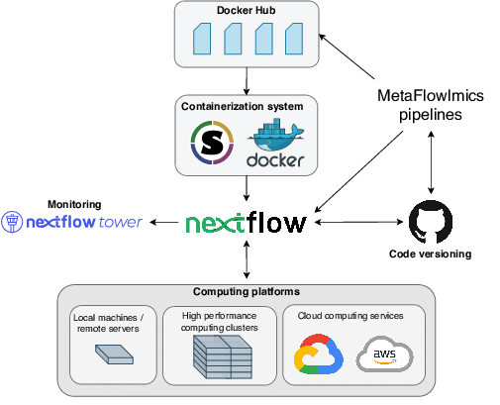
From scripts to workflows — building a reproducible pipeline (Nextflow preview)
Why Nextflow?
Scripts → OK for one step.
Workflows → connect many steps
Nextflow adds a thin abstraction layer:
You: describe the pipeline and dataflow
Nextflow: handles SLURM job configuration and submission
Benefits:
Not need to worry about:
Deploy slurm jobs
Parallelism
Resume tasks
Portability: minimum configuration to use your workflow in a laptop, HPC, Cloud…
Reproducibility (containers, safe resume, versioning…)

Slide 5
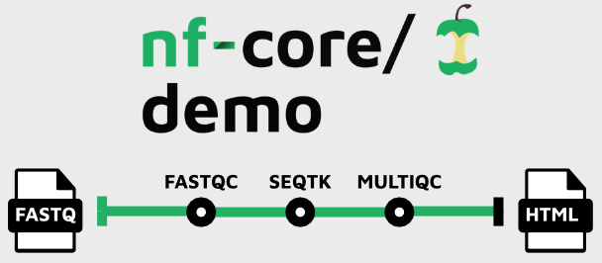
From scripts to workflows — building a reproducible pipeline (Nextflow preview)
Nextflow on Slurm
Create/Use a nextflow pipeline
https://nf-co.re/demo/dev/

Slide 6
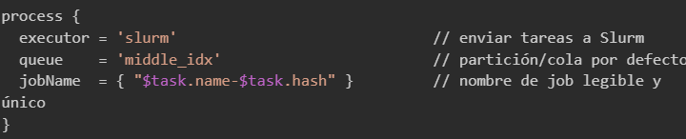
From scripts to workflows — building a reproducible pipeline (Nextflow preview)
Nextflow on Slurm
Create/Use a nextflow pipeline
Create a nextflow.config file

Slide 7
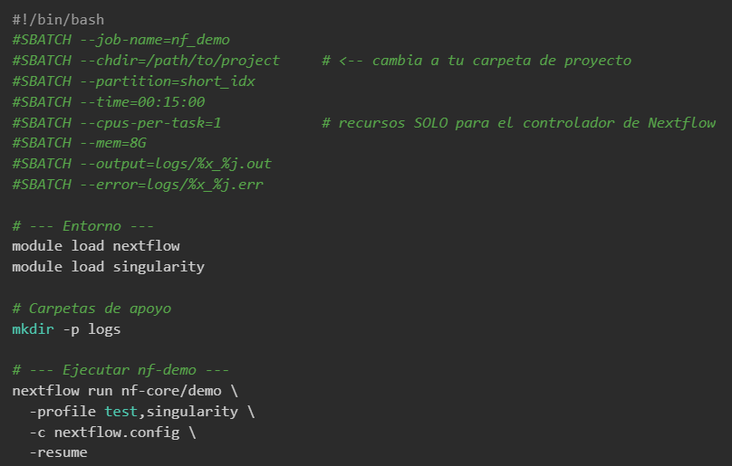
From scripts to workflows — building a reproducible pipeline (Nextflow preview)
Nextflow on Slurm
Create/Use a nextflow pipeline
Create a nextflow.config file
Create sbatch script

Slide 8
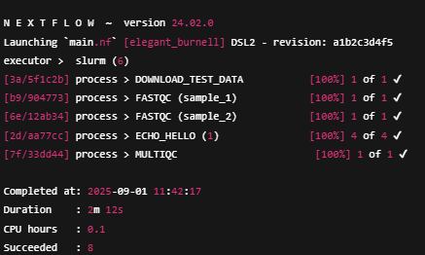
From scripts to workflows — building a reproducible pipeline (Nextflow preview)
Nextflow on Slurm
Monitor execution -- stdOUT

Slide 9
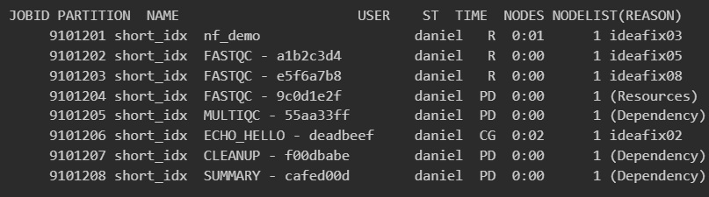
From scripts to workflows — building a reproducible pipeline (Nextflow preview)
Nextflow on Slurm
Monitor execution -- squeue -me

Slide 10
Thank you for your attention
Questions?

Slide 11
HANDS-ON

